Slide 1
Unit-VI

Slide 2
WSN
Cellular M2M
Software for IoT Applications
Hardware

Slide 3
Sensing and Sensors
Sensing is a technique used to gather information about a physical object or process, including the occurrence of events
An object performing such a sensing task is called a sensor
A sensor, then, is a type of transducer that converts energy in the physical world into electrical energy that can be passed to a computing system or controller.

Slide 4
Sensing and Sensors
An example of the steps performed in a sensing (or data acquisition) task
Phenomena in the physical world are observed by a sensor device
The resulting electrical signals are passed through a signal conditioning stage (tasks like amplification/attenuation/noise removal)
Analog signal is transformed into a digital signal using an analog-to-digital converter (ADC)
Signal is ready for further processing/ visualization/ storage
Many wireless sensor networks also include actuators which allow them to directly control the physical world

Slide 5
Sensing and Sensors
Data Acquisition and actuation

Slide 6
Sensing and Sensors
Sensor types
If the sensors require external power, they are referred to as active sensors. That is, they must emit some kind of energy (e.g., microwaves, light, sound) to trigger a response or to detect a change in the energy of the transmitted signal.
passive sensors detect energy in the environment and derive their power from this energy input – for example, passive infrared (PIR) sensors measure infrared light radiating from objects in the proximity

Slide 7
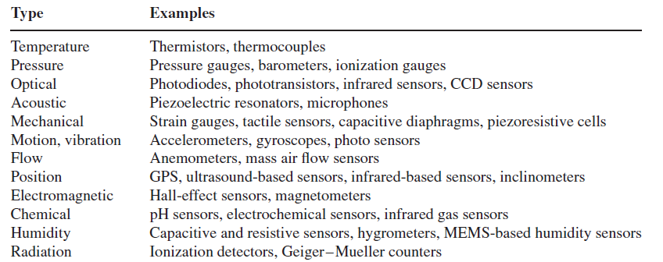
Sensing and Sensors
Sensor types

Slide 8
Wireless Sensor Networks
When many sensors cooperatively monitor large physical environments, they form a wireless sensor network (WSN)
Sensor nodes communicate not only with each other but also with a base station (BS) using their wireless radios, allowing them to disseminate their sensor data to remote processing, visualization, analysis, and storage systems

Slide 9
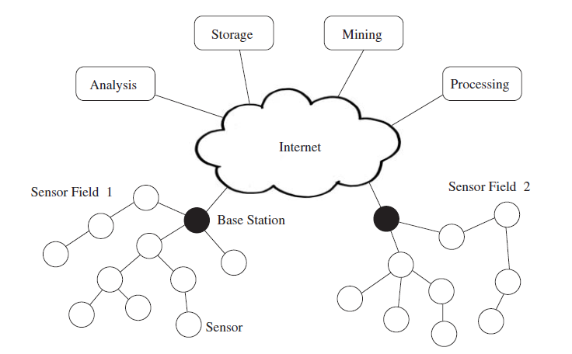
Wireless Sensor Networks
An example WSN with two sensor fields and their respective base stations

Slide 10
Wireless Sensor Networks
IEEE 802.15.4 is the protocol specifically designed for low power consumption wireless networks and is supported by most of the commercial sensor nodes.
When each node is within the range of the base station, it directly communicates with the base and forms a single-hop star topology.
In case of large geographical coverage, communication is done via intermediate nodes forming multi-hop mesh topology
In multi-hop topology, nodes must be capable of propagating sensor data towards base station.

Slide 11
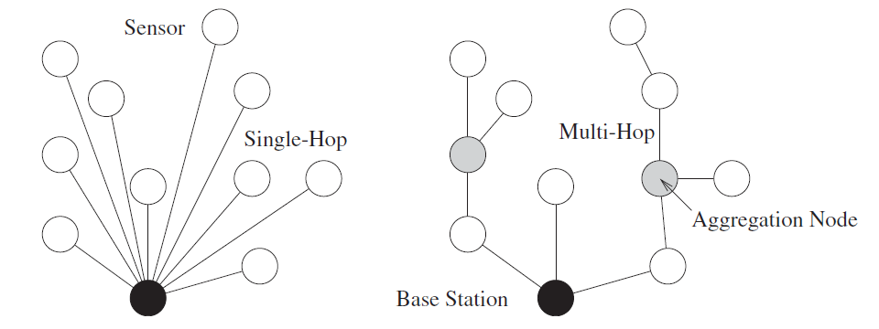
Wireless Sensor Networks
Single-hop vs Multi-hop WSN

Slide 12
Challenges & Constraints
Energy
Contention-based MAC strategies result in higher power consumption as the nodes may try multiple times to get access of the medium and may need to listen to the medium continuously
Therefore Contention-free MAC strategies are preferred as they allow strictly regulated medium access and allow nodes to turn off their radios when no communication is expected

Slide 13
Challenges & Constraints
Wireless Networking
a radio frequency (RF) signal fades
Multi-hop networks
Duty cycles further increases the problem

Slide 14
Challenges & Constraints
Self Management
Ad-hoc deployment
Deployment in predetermined locations is always not possible. Nodes have to determine their locations, search for available communicating nodes and work
Unattended operation
configuration, adaptation, maintenance, and repair must be performed in an autonomous fashion without human intervention

Slide 15
Challenges & Constraints
Decentralized Management
Due to large scale and energy constraints topology and routing management by base station is not feasible. Nodes have to collaborate with neighboring nodes and work through a non-optimal algorithms
Design Constraints
Cheaper
Small in size
Energy efficient
Wireless connectivity
Security
Unattended and wireless communication makes then susceptible to many security attacks i.e. Denial-of-service attacks

Slide 16
WSN Applications
WSNs have many advantages over traditional networking techniques.
They have an ever-increasing number of applications, such as infrastructure protection and security, surveillance, health-care, environment monitoring, intelligent transportation, and smart energy

Slide 17
WSN Applications
The applications can be divided in three categories:
Monitoring of objects.
Monitoring of an area.
Monitoring of both area and objects.

Slide 18
WSN Applications
Monitoring Area
Environmental and Monitoring
Precision Agriculture
Indoor Climate Control
Military Surveillance
Intelligent Alarms

Slide 19
WSN Applications
Example: Precision Agriculture
Precision agriculture aims at making agricultural operations more efficient, while reducing environmental impact and cost.
The information collected from sensors is used to evaluate optimum sowing density, estimate fertilizers and other inputs needs, and to more accurately predict crop yields.

Slide 20
WSN Applications
Monitoring Objects
Structural Monitoring
Condition-based Maintenance
Medical Diagnostics
Urban terrain mapping

Slide 21
WSN Applications
Monitoring Interactions between Objects and Space
Wildlife Habitats (Collar mounted sensors)
Disaster Management
Emergency Response
Asset Tracking
Health Care

Slide 22
WSN Applications
Example: Structural Health Monitoring
Global and local inspection of structures
Factors making WSN suitable for global inspection:
can be placed in areas that are inaccessible
By deploying a large number of nodes, it is possible to establish correlation between different measurements
does not require disruption of the normal operation of the structure

Slide 23
WSN Applications
Example: Structural Health Monitoring
Sensing seismic events
Challenges:
restrictions regarding the characteristics of the excitations
measurement noise
environmental constraints

Slide 24
WSN Applications
Biomedical / Medical
Health Monitors
Blood pressure
Oxygen saturation
Heart rate
Hospital Sensors
Monitor vital signs
Record anomalies
Monitor patient movements

Slide 25
WSN Applications
Numerous industrial and commercial applications:
Agricultural Crop Conditions
Inventory Tracking
In-Process Parts Tracking
Automated Problem Reporting
Theft Deterrent
Plant Equipment Maintenance Monitoring

Slide 26
WSN Applications
Example: Traffic Control
These systems gather information about the density, sizes, and speed of vehicles on roads; detect congestions; and suggest to drivers some alternative routes and emergency exits
Common methods used:
Video
sonar
Radar
Piezoelectric cables

Slide 27
WSN Applications
Military
Enemy tracking, battlefield surveillance
Target detection
Monitoring, tracking and surveillance of borders
Nuclear, biological and chemical attack detection

Slide 28
WSN Applications
Mobile Group Movement
Future military: attacking by sensor nodes
It needs coordination between nodes
Combination between AI (artificial intelligence), sensor technology and wireless communications
There is a goal for the nodes

Slide 29
Cellular M2M Application Networks
Monitoring Sensing
Communication Network
Monitoring Software

Slide 30
Software for IoT applications
Standardized End-to-end (E2E) Solution
1. Scalable Service Platform
2. Service Oriented Architecture
3. RESTful Architecture and so on.

Slide 31
Hardware
Main Hard devices used in the M2M Network are
Sensors
Memory Processors
Actuators
RFID
ADC/DAC
Power Module
Communication Module

